Slide 1





MEDISCRIBE
MEDENGINEERS
TEAM NO :15

Slide 2

PROBLEM
STATEMENT:
Imagine a doctor who just finished seeing a long line of patients. Instead of taking a break, they now have to spend extra time typing notes about each visit. This happens every day in clinics and hospitals.
Doctors spend hours writing down what the patient said, what they observed, and what treatment they gave.
This takes away time from actually helping more patients.
That’s why we built Medical Scribe — an AI tool that listens to the doctor-patient conversation and automatically writes the notes for the doctor, saving time and effort."

Slide 3

Vision
Create an AI Assistant for hospitals and clinic ‘s for Documentation.
Mission
Save doctor time, standardize notes, improve patient care.

Slide 4

SOLUTION :
That’s why we built Medical Scribe AI—an intelligent tool that listens to doctor-patient conversations, transcribes them, and automatically generates structured, EMR-ready notes, saving time and effort for doctors.

Slide 5
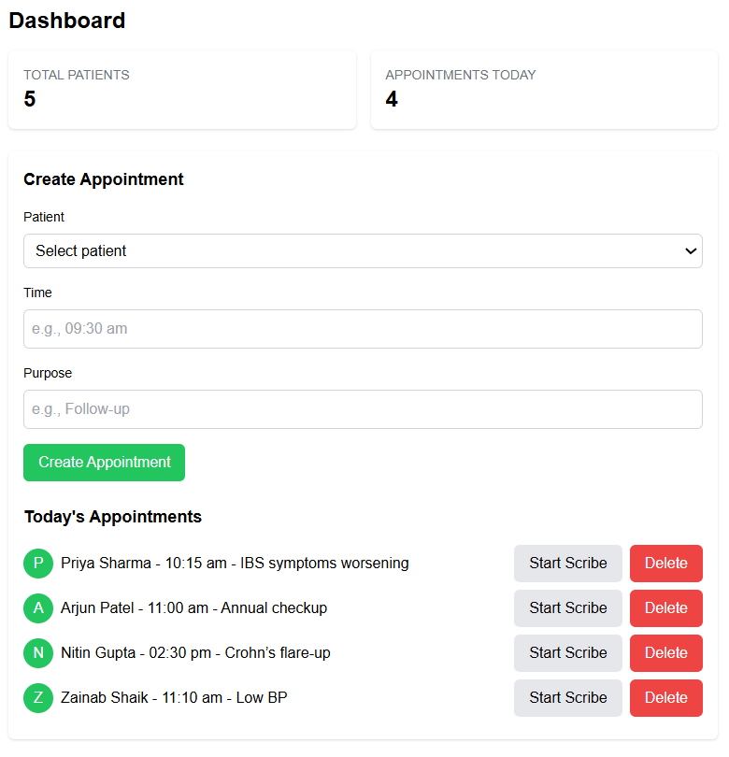
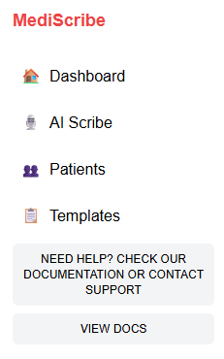

SNAPSHOTS :
MAIN
COMPONENTS

Slide 6
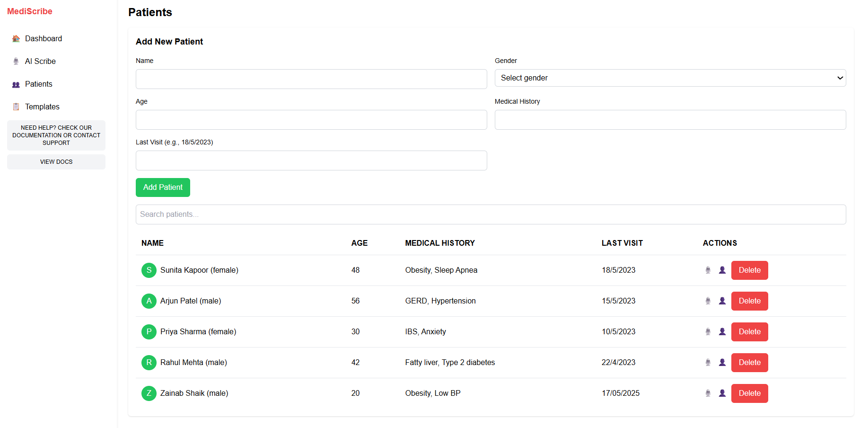
SNAPSHOTS :

Slide 7
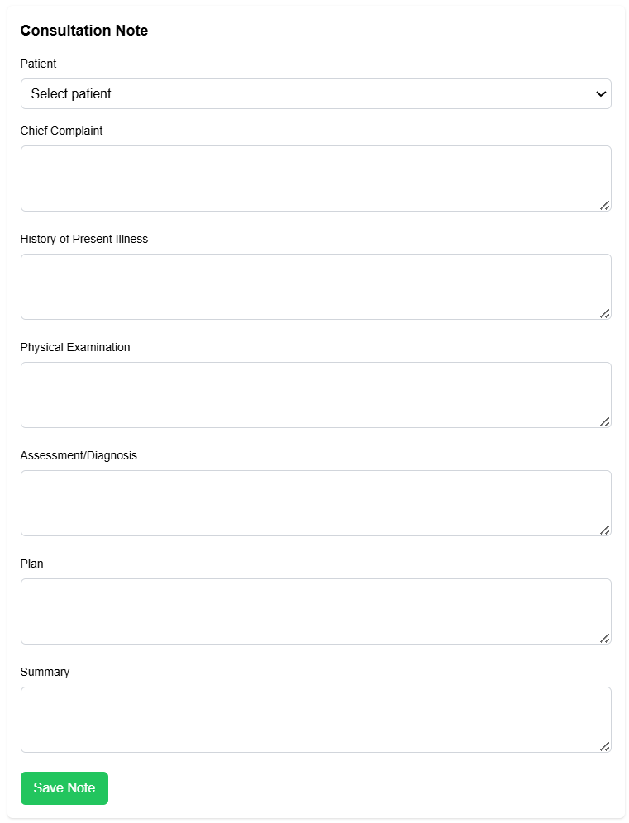
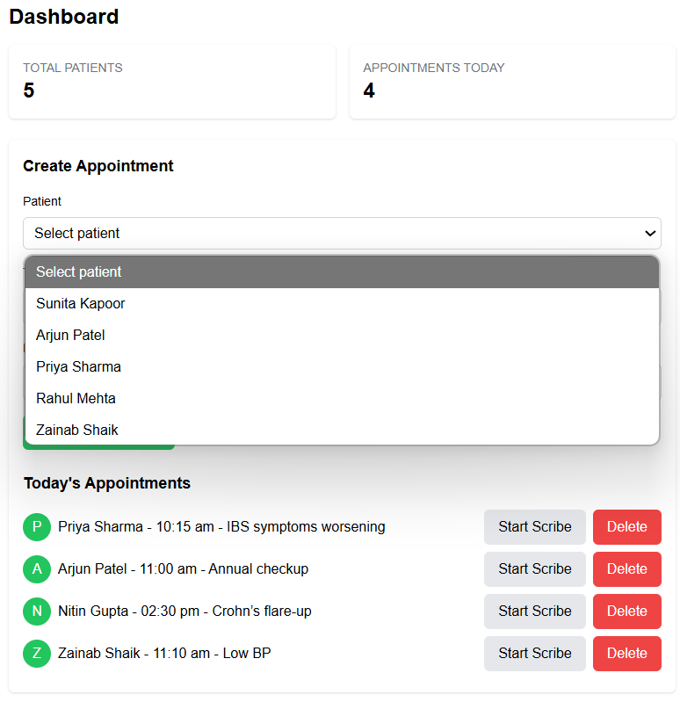
SNAPSHOTS :

Slide 8
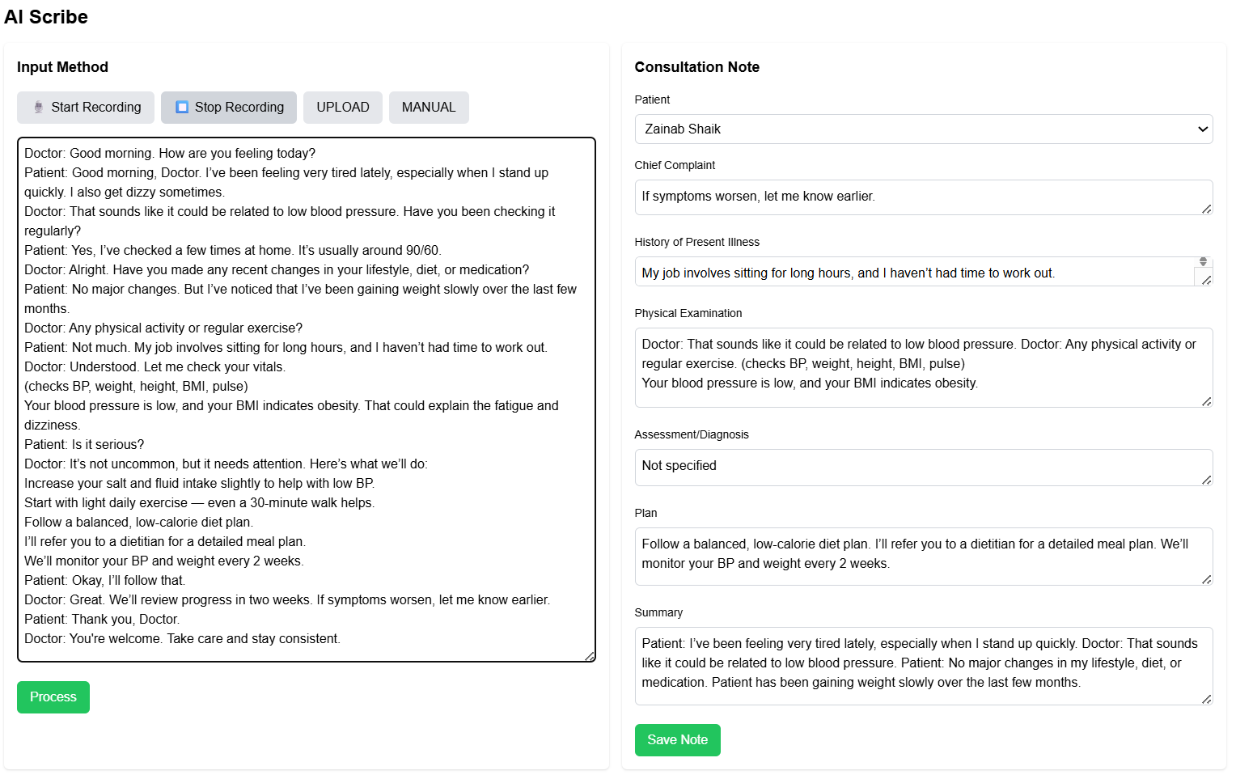
SNAPSHOTS :

Slide 9
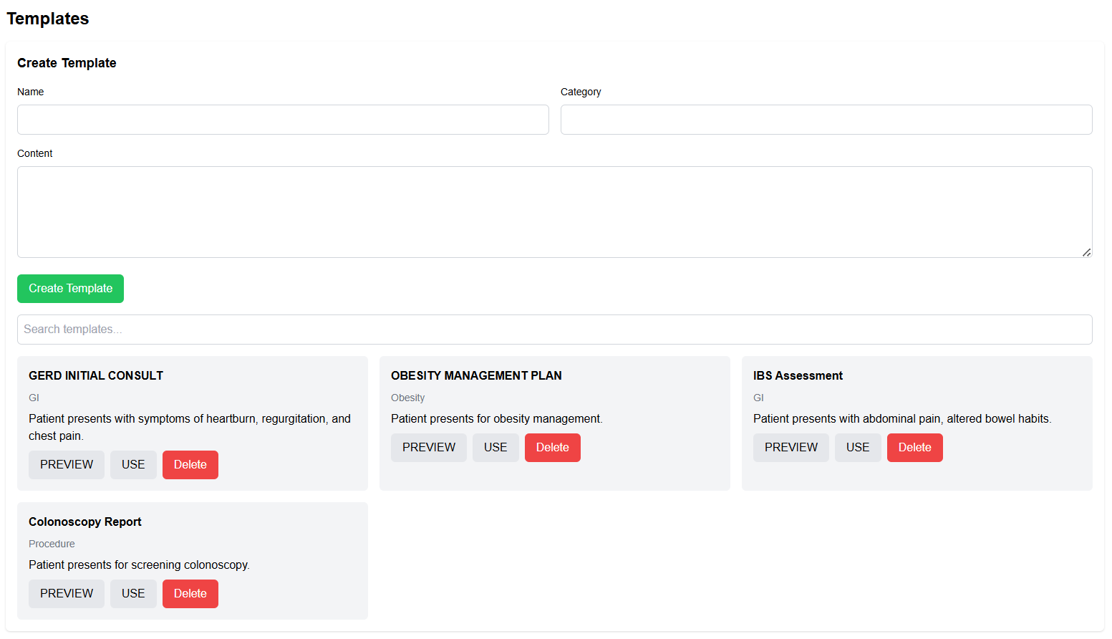
SNAPSHOTS :

Slide 10

THANK
YOU

